Slide 1
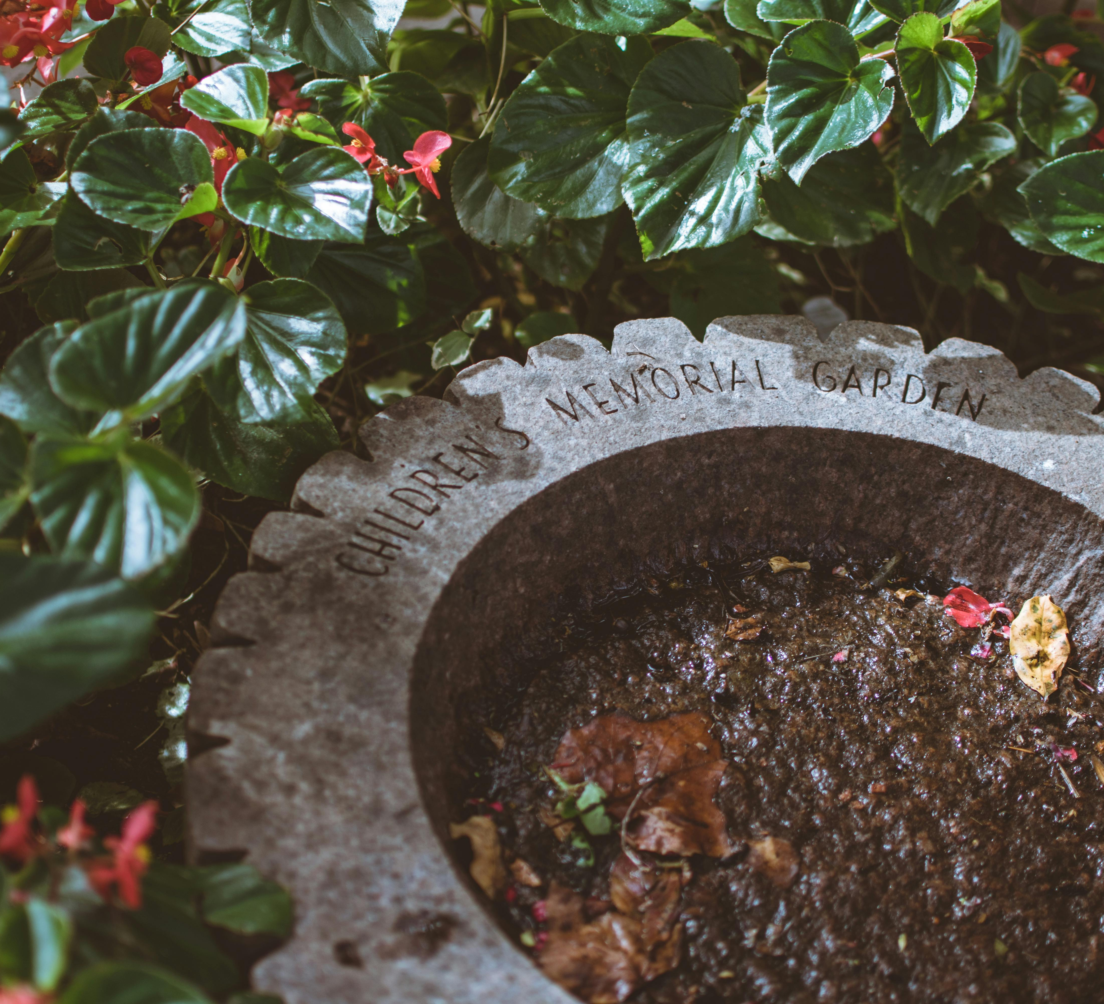
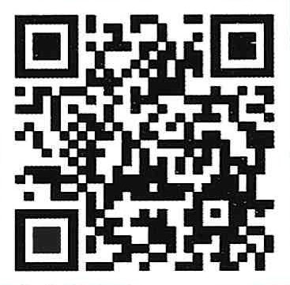
Advancing reproductive grief care in the church
Kim Ketola
Cradle My Heart Pastor’s Seminar
September 2025
Notes:
Quick survey
How many of you know someone impacted by the loss of a child before of shortly after birth?
How many of you know someone impacted by the loss of a child due to infertility, a contested divorce or termination of rights due to incarceration?
And how many of you felt adequately prepared by your study and training to address these losses with love and truth?

Slide 2

Reproductive grief
Half of all pregnancies every year end in loss
Nearly 2 million impacted, evenly split between miscarriage and abortion
Other losses include:
Stillbirth (1 in 6)
Infertility
Placing for adoption/lost custody
Loss of parental rights
Notes:
Reproductive Loss is common, but the grief is complicated and disenfranchised. Therefore, those who need help the most have the most trouble finding it, if they have the courage to reach out at all. I believe this is a holdover from a superstitious time when people believed a miscarriage was a curse from God. We are not under any such covenant as believers in Jesus Christ today.
But we do live under the modern American curse of abortion politics which loudly and boldly proclaims that children who die before birth were never even children at all.
What a cruel culture this is as a result of such thinking for those who suffer pregnancy and infant loss for any reason. Our losses are real, and we shouldn’t have to fight for the right to say so. Nor should we be silenced or shamed in our grief.

Slide 3
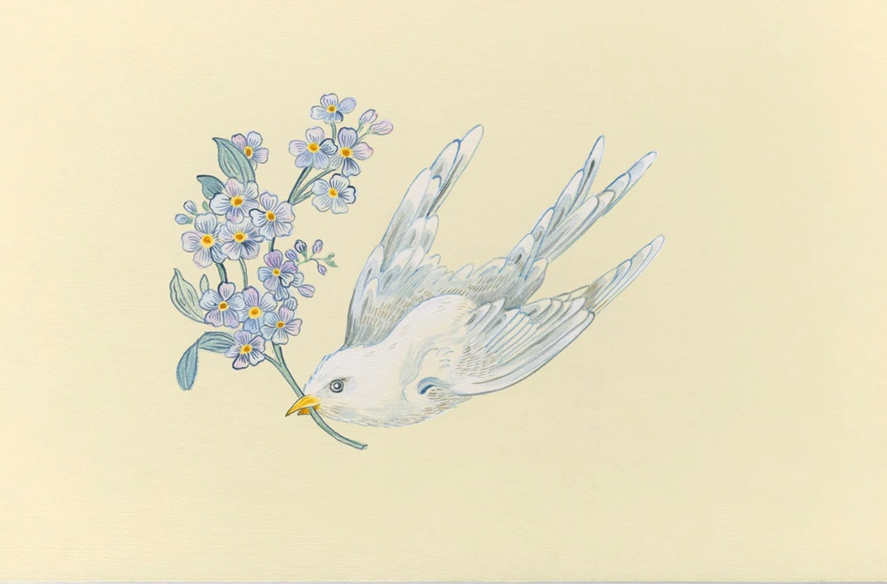
What happens to a baby when they die?
Jesus said, “Let the little children come to Me.” Mt19, Mk10, Lk18
“Unless you become as little children you will by no means enter the kingdom of heaven” Mt18
“Out of the mouths of infants and nursing babies God has ordained praise.” Mt21
Notes:
The premise: We must deal with heaven if we are to advance reproductive grief care.
God created children: he owns them, he holds them innocent, he ordains their worship of him from the very beginning. God regards them as:
As innocent: Jeremiah 19:4 4 “Because they have forsaken Me and made this an alien place, because they have burned incense in it to other gods whom neither they, their fathers, nor the kings of Judah have known, and have filled this place with the blood of the innocents
As his own: Ezekiel 16:20 “Moreover you took your sons and your daughters, whom you bore to Me, and these you sacrificed to them to be devoured. Were your acts of harlotry a small matter, 21 that you have slain My children and offered them up to them by causing them to pass through the fire? 22 And in all your abominations and acts of harlotry you did not remember the days of your youth, when you were naked and bare, struggling in your blood.
As purposeful for strength and worship: And Jesus said to them, “Yes; have you never read, "‘Out of the mouth of infants and nursing babies you have prepared praise’?” Mt 21:16Psalms 8:2Out of the mouth of babies and infants,you have established strength because of your foes, to still the enemy and the avenger.
See: Safe in the Arms of God/MacArthur, I’ll Hold You in Heaven/Hayford

Slide 4

complicated spiritual grief screening
Does God exist, and does he care for me?
Did this pregnancy represent a life and not just potential life?
Is this loss a punishment? How can I be forgiven?
Is abortion wrong and a sin?
How can I overcome shame from acting against my moral values?
How can I trust myself and others after this loss?
Notes:
Inventory of Complicated Spiritual Grief Burke and Neimeyer‚ 2016
This instrument can be found at: http://www.mdpi.com/2077-1444/7/6/67/pdf
1. I don’t understand why God has made it so hard for me.
2. I have withdrawn from my fellowship with other believers.
3. I go out of my way to avoid spiritual/ religious activities (e.g.‚ prayer‚ worship‚ Bible reading).
4. I no longer feel safe and protected by God.
5. I find that spiritual/religious activities are not very fulfilling (e.g.‚ prayer‚ worship‚ Bible reading)
6. I find it impossible to pray.
7. I struggle with accepting how a good God allows bad things to happen.
8. I find it difficult to surrender my life to God.
9. I don’t feel as comforted by church fellowship as I used to.
10.I can’t help feeling angry with God.
11.I don’t feel very much like joining in fellowship to praise God or to glorify Him.
12.The strong guiding light of my faith has grown dim and I feel lost.
13.I’m confused as to why God would let this happen.
14.I have lost my desire to worship.
15.I find it impossible to worship.
16.I feel my loss is unfair.
17.I sense the absence of God more than I do the presence of God.
18.I am a faithful believer‚ so I don’t understand why God did not protect me.

Slide 5
Complicated perinatal grief risks/protections
RISKS
PROTECTIONS
History of other mental illness
Marginalized person or group
Childless
Instability of marriage/relationship
No provider time/tools
Unresolved loss
Spirituality
Building a life
Follow up with provider
Assessment tools
Support Groups/CBT
ANY therapy is better than none
Notes:
Perinatal Loss: The Impact on Maternal Mental Health, Teni Davoudian, PhD 2021
Dr. Davoudian is a board-certified Health Psychologist with expertise in reproductive mental health. She provides psychotherapy to patients who are pregnant, postpartum or seeking fertility Texas Children’s Health
The risks for complicated grief:
History of other mental illness
Marginalized person or group
Childless
Instability of marriage/relationship
Lack of knowledge
Unresolved loss

Slide 6
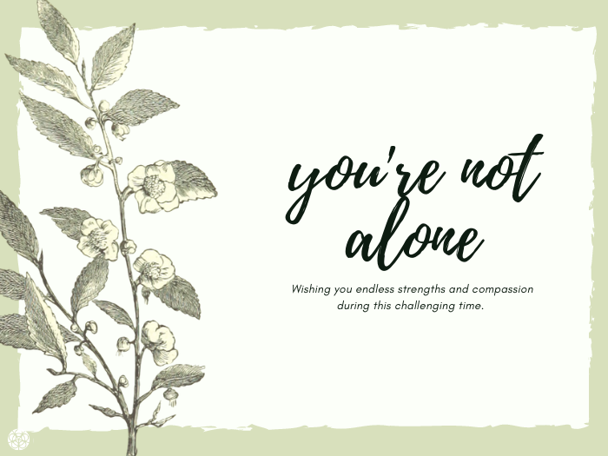
What helps
5 Things people wish for after reproductive loss:
1. Follow up
2. Listen and don’t assume
3. Offer resources
4. Ask how they are
5. Written info to take home
Dr. Teni Davoudian
Notes:
Perinatal Loss: The Impact on Maternal Mental Health, Teni Davoudian, PhD 2021
Dr. Davoudian is a board-certified Health Psychologist with expertise in reproductive mental health. She provides psychotherapy to patients who are pregnant, postpartum or seeking fertility Texas Children’s Health
Intensity of loss can be equal to other deaths of loved ones
People may present as
Overwhelmed
Tired
Avoidant
Depressed
Actively mourning and grieving

Slide 7
Abc’s OF TRAUMA
KEY QUESTIONS
What happened to you?
How do you make sense of what happened?
How does your story fit into the bigger story God is writing in the world?
Trauma: anything that stunts maturity development.
• A trauma - the absence of something I needed (comfort, affirmation, training, etc.)
• B trauma - the bad things that happen to us (verbal, psychological, physical, and sexual abuse)
• C trauma - the comparisons that lead to warped narratives that damage our development and ability to function.
Notes:
Biblical trauma care and recovery resources can be found at deeperwalk.com

Slide 8

Moral injury screening after abortion
“Moral Injury is the sum total of the psychological, social, and physiological consequences that a person undergoes, when all three of the following are present:
1. Betrayal of what’s right
2. By someone who holds legitimate authority
3. In a high-stakes situation
Notes:
Psychiatrist Jonathan Shay is credited with being the first to articulate a definition of moral injury.¹¹ In his 1994 book Achilles in Vietnam: Combat Trauma and the Undoing of Character, Shay described how many of the Vietnam veterans he counseled in the Boston, MA, Veterans Affairs clinic suffered from a condition that seemed like PTSD but had a cause that was not recognized in the APA’s definition of a traumatic event. Indeed, military combat is rife with traumas that could lead to PTSD. However, the particular sufferings that Shay was attempting to define, he argued, were the consequences of veterans violating conscience, or their sense of “what’s right,” in the course of carrying out their duties.
https://humanlifereview.com/when-abortion-causes-moral-injury/
As applied to abortion, the woman knows it’s wrong but the doctor and the law allow it and the stakes are so high she follows what they say against her own moral sense.
The Military Moral Injury and Distress Scale available here: https://www.ptsd.va.gov/professional/assessment/documents/NCPTSD_MIDS.pdf
I acted in ways that violated my own morals or values. 1a. I am bothered by what I did. 2. I violated my own morals or values by failing to do something I should have done. 2a. I am bothered by what I did not do. 3. I saw things that violated my own morals or values. 3a. I am bothered by what I saw. If all answers equaled 0, skip the rest of this questionnai
Because of what I did, failed to do, or witnessed that went against my morals and values… Not at all A little Moderately Quite a bit Extremely 1. I think about how I should have been able to do more. 2. I have withdrawn from others more often. 3. I feel guilty. 4. I doubt my own judgement. 5. I do not feel like I deserve to be happy. 6. I self-sabotage things in my life more often (relationships, things at work). 7. I feel helpless. 8. My life feels like it has less purpose. 9. I am worried that bad things will happen to me or my loved ones. 10. I have punished myself. 11. I feel disgusted. 12. I do not seek support because I feel like I do not deserve it. 13. I do not seek support because I worry others would not understand. 14. I feel betrayed by leaders or institutions. 15. I feel powerless. 16. I should not be forgiven. 17. My spirituality/faith is no longer a source of comfort. 18. I do not take good care of myself.

Slide 9
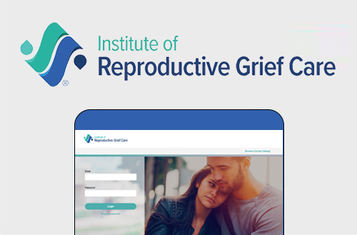
Reproductive Loss Screening
1. How much are you having trouble accepting your loss?
2. How much is your pain interfering with your life?
3. How often are you having reminders of your loss?
4. How often are you avoiding things you used to do before your loss?
5. How hard is connecting with other people, including family or friends?
Notes:
From the Institute for Reproductive Grief Care
Research results
https://www.sciencedirect.com/science/article/pii/S2772628223001243
How it works poster https://static1.squarespace.com/static/674e3fa0de201241778ef1e5/t/6781b1c66ab9db091671e9ef/1736552902540/Reproductive-Loss-Screener-Research-Process-FINAL-1536x864.jpg

Slide 10
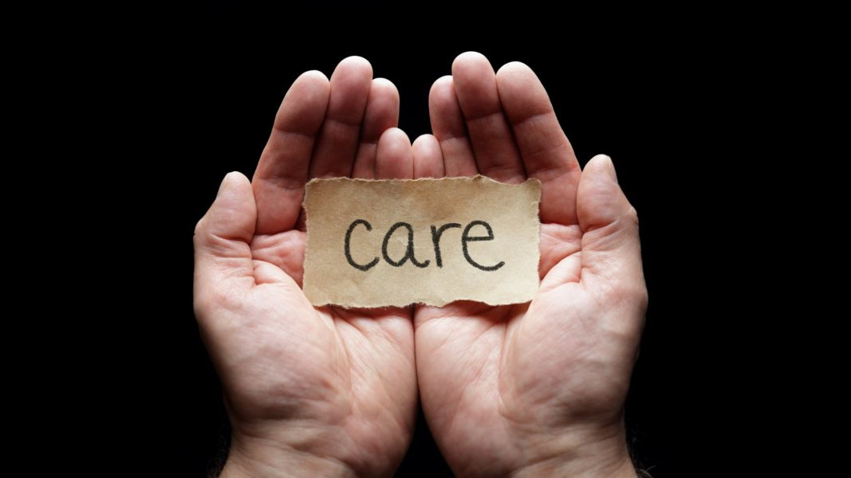

Words matter
Would it help to talk about it?
Would you like to have a memorial service?
Here is some food that I made for you.
My heart breaks for you. Is there anything that I can do to help?
No one is judging you.
I don’t know what to say, but I am here to listen.
You are not alone. I am here for you. And I always will be.
Notes:
From the Institute for Reproductive Grief Care

Slide 11
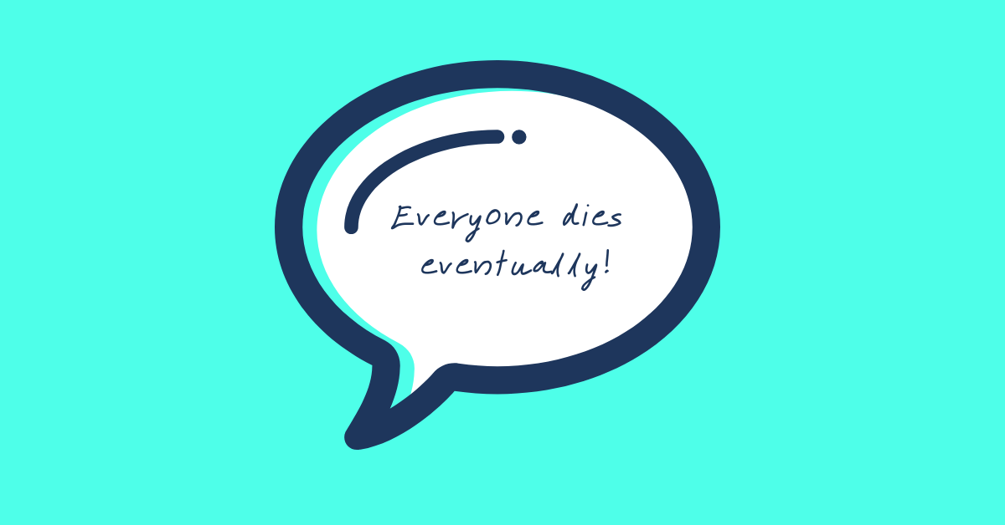

Words can hurt
You’re young, you can always try again.
God wanted your child in heaven. Your child is in a better place now.
Your miscarriage was so long ago, shouldn’t you be over it by now?
There was probably something wrong with it anyway.
Do you think you did something to make it happen?
Abortion is nothing to be ashamed of.
You did the best you could, it’s legal after all.
Notes:
From the Institute for Reproductive Grief Care

Slide 12
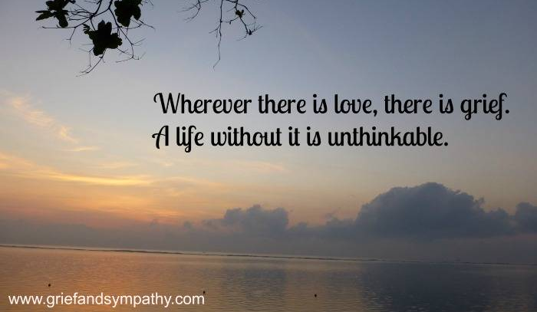
Healing Model – essential needs and challenges
Guilt and Blame
Disordered Worship
Doubt
Shame
Forgiving
Repenting
Sifting
Grieving
Rejoicing
Returning
Notes:
From Cradle My Heart
Pregnancy and infant loss is not mentioned in the Bible, but the needs of the human heart have not changed. Jesus ministered his healing love to people in ways that can still heal us today, even after abortion.
The lame man at the pool learned to get up and move on from crippling blame.
The woman at the well was thirsting for lasting love when Jesus revealed himself as one finally worthy of her worship
Eve doubted God and the whole world has suffered as a result. Yet the whole world can be redeemed in the love of Jesus Christ
The woman with the issue of blood spent all of her time and all of her money seeking healing. She learned to crawl when she met Jesus that day, and he gave her the opportunity to stand up unashamed and witness his purifying touch in her life
The guards who gambled for his cloak could not have cared less about Jesus as they persecuted him prior to his execution, they were in it for personal gain. Yet he forgave them. How will he not forgive even us, no matter how selfish and wrong our lives and our motives may have been
The woman who washed his feet with her tears showed the hard-hearted men all around her how very much Jesus values our emotions and our loving response to his forgiving love as we repent and turn to him
Sifting is reserved for those with the very strongest faith. Job and Peter are marked out for it in the Scriptures. Jesus says the purpose is to forge a faith strong enough to lead others. You may have believed you’d be immune from such loss or sin due to your strong faith. Jesus is praying for you!
When Jesus asked Where Have You Laid Him, he invited the mourners to return to their place of deep sorrow. He will go with you to reveal to you his resurrection power
Jesus said Let the little children come to Me. If here on earth, how much more will he receive them in heaven?
Zaccheus was guilty of appropriating the wealth of his fellow Jews yet Jesus went to his home and assured him of salvation. Zaccheus responded by returning his ill-gotten gains and donating above and beyond. Our restoration benefits others as we respond in deep gratitude for all the Lord has done for us.

Slide 13

Healing Model – essential grieving tasks v stages
Acknowledge
Accept
Connect
Adapt
Grief is just love
with no place to go
-Jamie Anderson
Notes:
From Support After Abortion supportafterabortion.com
Acknowledge where you are now with the loss as a starting place to move through grief. Acknowledging the loss of a child allows you to express how you feel which helps you stay present in your grief gaining strength, rather than avoiding or denying emotions
Accept the loss of your child. We cannot change reality, but we can change how we react to it. We can accept the loss and any iniquity or sin attached to it by accepting the free gift of grace given to us in Christ
Connect with the loss by honoring the child. Memorials, rituals, sharing your story and many other actions help replace the painful memories and give honor and dignity to the memory of their brief but meaningful lives. You may want to name your child in heaven though not all parents do so
Adapt to life in the present. You will never forget the loss. You can choose to grow as your healing continues.
From Keys to Hope and Healing, Support After Abortion and Word Among Us
“Grief, I’ve learned, is really just love. It’s all the love you want to give, but cannot. All that unspent love gathers up in the corners of your eyes, the lump in your throat, and in that hollow part of your chest. Grief is just love with no place to go.”― Jamie Anderson
Support After Abortion crafting a new approach
10-20% acknowledged adverse change
90% didn’t know where to go
Only 2% said they’d go to church or faith-based agency
Research Insights
Debunk the myth that few are hurt, when there are millions to help
Shift the paradigm in how we approach abortion healing
Many people in need of healing are outside “the church”
Change the narrative and focus on the person in need of healing
Create capacity for healing w/ options-based programs and curriculum

Slide 14
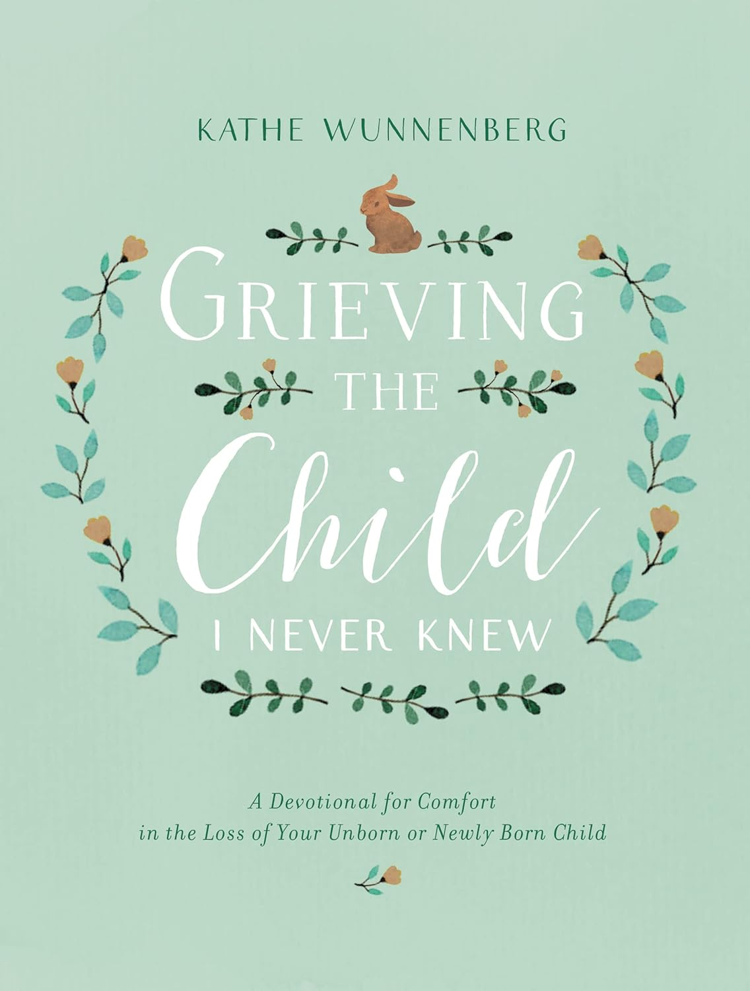
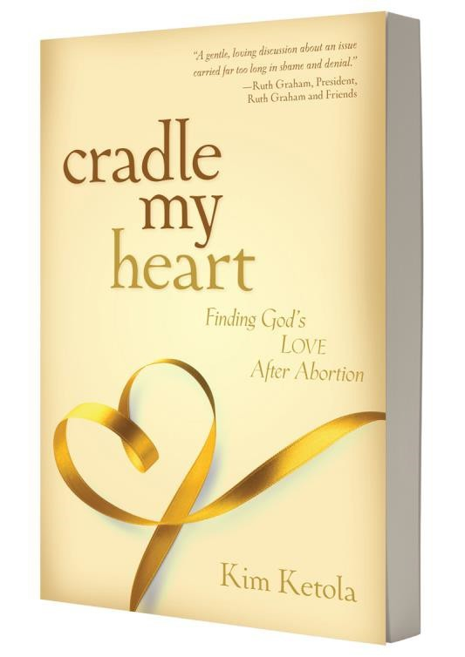
A biblical resource
Grieving the Child I Never Knew: A Devotional for Comfort in the Loss of Your Unborn or Newly Born Child by Kathe Wunnenberg
“You go through what you go through so you can help someone get through what you went through.”
Notes:
Kathe Wunnenberg knows the deep anguish of losing a child, having experienced three miscarriages and the death of an infant son. Grieving the Child I Never Knew is a 31-day devotional to help mothers:
Grieve honestly and well
Process gentle questions and insights from others
Cultivate a healing journey that works for them
Each devotion includes:
Scripture passage and prayer
Steps Toward Healing questions
Space for journaling
Readings for holidays and special occasions
Grieving the Child I Never Knew is a wise and tender companion for mothers whose hearts have been broken--mothers whose dreams have been shattered and who wonder how to go on.

Slide 15
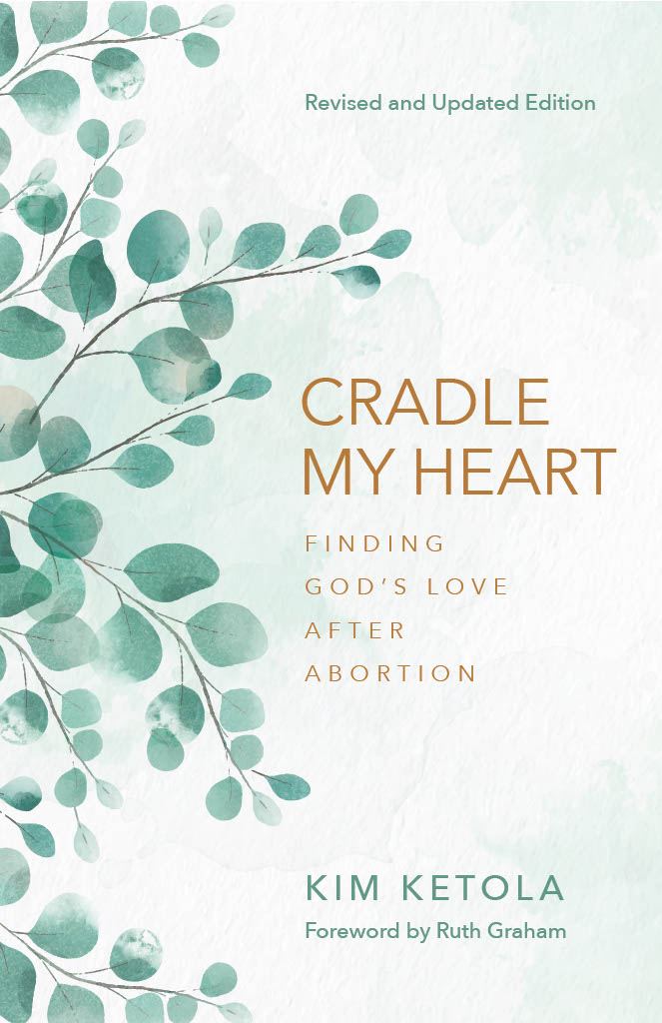
A biblical resource
Cradle My Heart, Finding God’s Love After Abortion by Kim Ketola
“For the millions of Christian women who now wish that we could know and love the children we thought we did not want”.
Notes:
Biblical encounters with Jesus left people changed and healed. We can apply those healing principles to the many spiritual wounds of abortion. Women may need to learn to exchange accountability for blame, to satisfy their true thirst for Someone to love and worship, to listen to truth and stop believing lies, to move past shame as we receive our imputed righteousness from Christ, to forgive and be forgiven, to grieve with hope, to offer restitution as appropriate and to share the comfort with we have been comforted.

