Slide 1

A Spiritual Approach
To Reproductive Loss
Kim Ketola
Christian Chaplains and Coaching 2023

Slide 2

Pregnancy loss is a spiritual crisis
Northwest Community Healthcare in Illinois offers a Pregnancy and Infant Loss Program for all losses excluding abortion.
Part of the program is an annual butterfly release as a healing ritual. A memorial garden and an annual walk also provide places and spaces to grieve in community.
https://www.nch.org/conditions/womens-health/obstetrics/pregnancy-infant-loss-program/
Notes:
Multidisciplinary team approach to your care including OB physician, neonatologist, maternal-fetal medicine, nurse, perinatal palliative care, social worker, chaplain, lactation specialist, respiratory therapist and pharmacist
Pregnancy loss is a matter of life and death, and as such drives life’s most spiritual questions:
Does God exist, and does he care for me?
Did this pregnancy really represent a life and not just potential life?
Why did God allow this?
Is abortion a sin and an offense to God?
Is miscarriage punishment or judgment for past wrongs?
How can I be forgiven?
How can I trust myself and others after this loss?
How can I overcome shame from acting against my moral values?

Slide 3
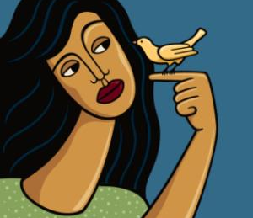

Listening to Loss
Are Christians impacted?
Notes:
Little bird told me—Bible study disclosures
Half of all US pregnancies end in miscarriage or abortion
The majority of women (70%) who have had abortions say their religious preference is Christian.
Nearly half of women who have had abortions were churchgoers when they ended their pregnancy
Over half say no one at church knows about it.
Three-fourths of women who have had abortions say the church had no impact on that decision
Guttmacher Fact Sheet Induced Abortion in the United States
https://www.guttmacher.org/fact-sheet/induced-abortion-united-states
WHO HAS ABORTIONS?
At 2014 abortion rates, about one in four (24%) women will have an abortion by age 45.4
More than half of all U.S. abortion patients in 2014 were in their 20s: Patients aged 20–24 obtained 34% of all abortions, and patients aged 25–29 obtained 27%.5
Adolescents made up 12% of abortion patients in 2014: Those aged 18–19 accounted for 8% of all abortions, 15–17-year-olds for 3% and those younger than 15 for 0.2%.5
White patients accounted for 39% of abortion procedures in 2014, black patients for 28%, Hispanic patients for 25%, and patients of other races and ethnicities for 9%.5
Seventeen percent of abortion patients in 2014 identified themselves as mainline Protestant, 13% as evangelical Protestant and 24% as Catholic, while 38% reported no religious affiliation and the remaining 8% reported some other affiliation.5
The vast majority (94%) of abortion patients in 2014 identified as heterosexual or straight. Four percent of patients said they were bisexual; 0.3% identified as homosexual, gay or lesbian; and 1% identified as "something else."5
Fifty-nine percent of abortions in 2014 were obtained by patients who had had at least one birth.5
Some 75% of abortion patients in 2014 were poor (having an income below the federal poverty level of $15,730 for a family of two in 2014) or low-income (having an income of 100–199% of the federal poverty level).5
In 2014, 16% of patients who obtained abortions in the United States were born outside the United States, a proportion comparable to their representation in the U.S. population (17% of women aged 15­–44).5
In 2014, 51% of abortion patients were using a contraceptive method in the month they became pregnant, most commonly condoms (24%) or a short-acting hormonal method (13%).6

Slide 4
Meeting the Spiritual Challenges of Loss
Guilt and Blame
Disordered Worship
Doubt
Shame
Forgiving
Repenting
Sifting
Grieving
Rejoicing
Returning
Notes:
Abortion hardens hearts and abortion breaks hearts. Discern if either has happened before you proceed
Address the various spiritual issues which present with gospel truth

Slide 5
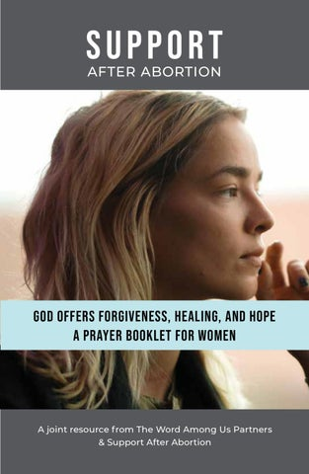
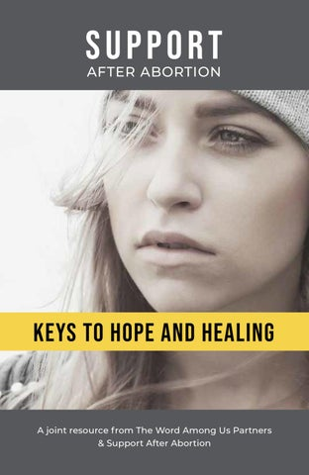
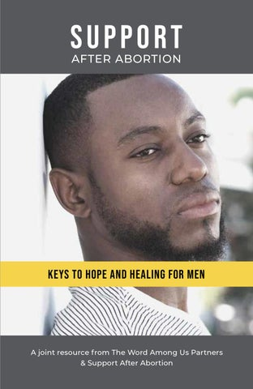
Support After Abortion supportafterabortion.com
Notes:
Grief work
Acknowledge
Accept
Connect
Adapt
Tasks v stages of grief places control with the individual working through grief
Clinical and faith-based materials available
Suitable for groups, one-on-one or virtual self-guided

Slide 6

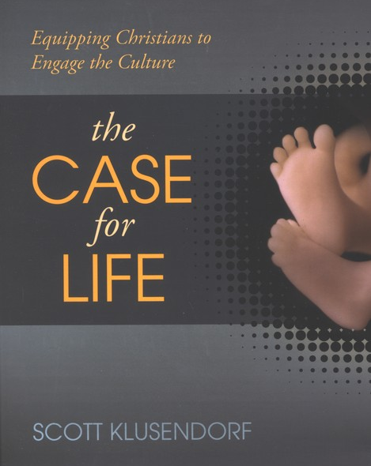
Pro-life apologetics and
The One-Minute Case for Life
Embryology teaches that from conception forward you were a distinct, living, whole human being. You didn’t come from an embryo; you once were an embryo. There is no morally significant difference between the embryo you once were and the adult you are today. Differences of size, level of development, environment and degree of dependency are not good reasons to say you could be killed then but not now.
Notes:
The Case for Life by Scott Klusendorf
Tactics and Stand to Reason online resources by Greg Koukl

Slide 7
Integrate Spirituality into Care: Step One - Ask
Pregnancy history and a brief spiritual history
  Religious background
  Role that R/S beliefs or practices play in coping with illness (or causing distress)
  Level of participation and support in R/S community
  Spiritual needs that might be present.
NOTE: It is the health professional, not the chaplain, who is responsible for doing this two-minute “screening” evaluation. ASK if an eval has been done

Slide 8
Integrate: Step Two - Acceptance
Beliefs stated should always be respected.
Take a neutral posture and ask questions to obtain a better understanding of the beliefs.
Do not challenge stated beliefs
Encourage health professional who are knowledgeable about a patient's R/S beliefs and the beliefs appear generally healthy, to actively support those beliefs and conform the healthcare being provided to accommodate the beliefs.

Slide 9
Integrate: Step Three - Refer
Most providers without CPE do not have the skills or training to competently address patients' spiritual needs or provide advice about spiritual matters.
Chaplains have extensive training on addressing spiritual issues. Welcome referrals and offer your services to providers
SOURCE: Harold G. Koenig, "Religion, Spirituality, and Health: The Research and Clinical Implications", International Scholarly Research Notices, vol. 2012, Article ID 278730, 33 pages, 2012. https://doi.org/10.5402/2012/278730

Slide 10
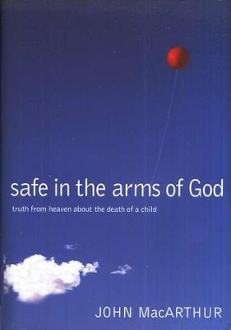

Resource for the Hope of Heaven
Safe in the Arms of God, Truth from Heaven about the Death of a Child
by John MacArthur

Slide 11
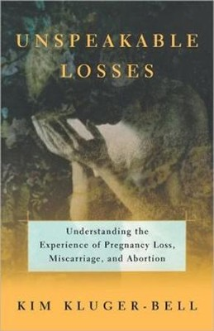
Resource for Miscarriage
Unspeakable Losses: Understanding the Experience of Pregnancy Loss, Miscarriage, and Abortion
By Kim Kluger-Bell

Slide 12
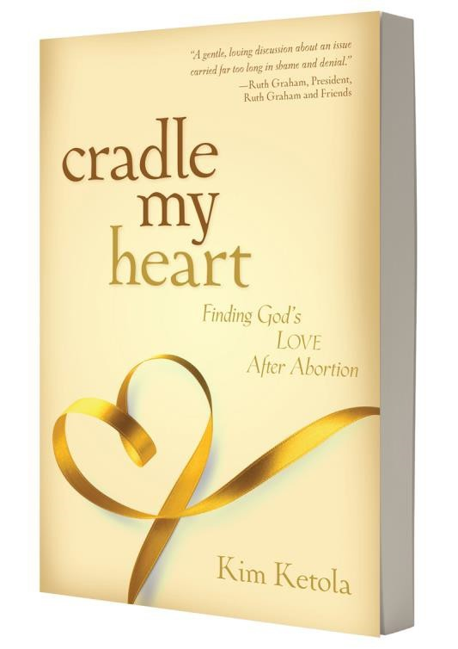
Bonus Material
Scriptural examples and case studies from
Cradle My Heart, Finding God’s Love After Abortion

Slide 13
Do you want to get well? John 5:1-15
  BLAME is crippling; spelled B-lame
  Religious people may be part of the problem
    Affliction as identity
      The comfort of the curse
Spiritual solution: Accountability
Notes:
Case study—the 75-year-old who says she will never forgive
Chaplain skills– motivating faith in One higher than self and others
Miscarriage application—the biggest hurdle is blaming self or God

Slide 14
Will you give me a drink? John 4:4-42
A story about THIRST
  Our thirst disorder is a worship issue
    How God sees us
      The comfort of being known by God
Spiritual solution: Honest confession
Notes:
Sheila Case Study (GF) teen abortion, secret sin drains us and leaves us thirsting for truth
Chaplain skills: encourage the story, listening with empathy, offering both grace and truth
Miscarriage application – thirsting for acceptance and God’s grace

Slide 15
It is written. . . Mt. 4:1-11
The tempter tempts us to DOUBT
  Jesus answered with biblical truth
    Case for Life
      Genesis and James – made in God’s image
        Exodus and Matthew – do not murder
Spiritual solution: Scriptural truth
Notes:
Case study – Danielle and the added grief of racism whereby abortion is sold as responsible and a cure for poverty
Chaplain skills: develop a pro-life apologetic through The Case for Life or Stand to Reason
Miscarriage application – affirm a real loss has taken place

Slide 16
Who touched Me? Mark 5:21-34
SHAME destroys our dignity as women
  We too spend all our time and money seeking a cure
    Jesus came to radically change the system of purity
      Imputed righteousness
      Our witness
Spiritual solution: Community
Notes:
Case study – Paula coerced abortion and domestic violence
Chaplain skills – model acceptance, connect the dots to shame and avoidance, perfectionism, codependency
Miscarriage application – loss of control and feelings of failure

Slide 17
One forgiven much Luke 7:36-50
REPENT: the remedy for broken hearts
  Godly sorrow 2 Cor. 7: 9-11
    Guilty worldly sorrow a dead end
      Jesus is comfortable with our emotions
Spiritual solution: Foster repentance
Notes:
Case study – Molly’s worldly sorrow became godly sorrow when she knew the love of God
Chaplain skills – know the difference 2 Corinthians 7: 8-11
Worldly sorrow signs: Avoidance, guilt, shame, remorse, self-loathing, self-destruction, justification, confusion, despair over complicated mourning
Godly sorrow signs: truthful, forgiving and accepting forgiveness, concern for others, a desire to be cleared, indignation over deception of self and others, ready for justice, desire to do right, longing with hope for your children
Bonus: Recognize “memorializing the pain”
Miscarriage application – encourage receiving love from others

Slide 18
Father, forgive them Luke 23
What is the goal of your faith?
  Are we truly practicing agency and autonomy
    Did we know all that would be lost?
      Did we know it was wrong?
Spiritual solution: Mercy for all
Notes:
Case study Jeannie – two men forced abortion but later married an became fathers. The rejection and pain was intense
Chaplain skills – encouraging self-love and self-forgiveness based on God’s unconditional love for us, see also Paul’s statement that he was a blasphemer and ignorant
1 Timothy 1:13
Even though I was once a blasphemer and a persecutor and a violent man, I was shown mercy because I acted in ignorance and unbelief. New Living Translation
Miscarriage application – reassuring and honoring the memory of the lost child

Slide 19
Let the children come Matt 19:13-14
HOPE is eternal
Heaven is for children
  Jesus blessed children
    Nothing in Scripture prohibits it
      Safe in the Arms of God
Spiritual Solution: Sound doctrine
Notes:
Case study – Laurie struggles due to baptism and original sin/MacArthur story
Chaplain skill: know the truth and confidently reassure
Miscarriage application-directly the same as abortion—the children are secure with God

Slide 20
Do you love Me? John 21:15-23
When Christians choose abortion
  Peter sifted as wheat
    Failure fits us for ministry—to strengthen others
      Jesus didn’t call us to be perfect, he calls us to be his
Spiritual Solution: Share God’s love
Notes:
SKIP ON CHAPLAIN CALL Case study-Bonnie from a pro-life Christian family, aborted to protect the family reputation. She confided this at the abortion and a worker said, “Well you won’t be doing that anymore!” with a snide laugh. When she later told her father he was compassionate and accepting. And today they work together advocating for women in crisis pregnancy
Comfort others with the comfort with which we have been comforted
Chaplain skills – knowing the value and purpose of sifting from a biblical point of view. It is a spiritual challenge reserved for those of strong and demonstrated faith. Also knowing that holiness produces morality and not vice versa
Miscarriage application—the loss of a loved one can very much be a sifting regardless of circumstances. CS Lewis Great Divorce test for admission to heaven.

Slide 21
Where have you laid him? John 11:1-44
Returning to the place of our grief
  The value of memorials
    New research re: oxytocin and fetal maternal bonding
      Helps us to stop the cycle of attaching to the painful memories and memorializing pain
Spiritual Solution: Good grief and mourning
Notes:
Case study-Joanna’s multiple abortions left her infertile. She had to disclose this to her faithful husband who did not know this part of her history prior to their relationship. His acceptance and grieving their inability to conceive drew them closer and allowed Joanna to move forward in their marriage and her faith
Chaplain skill – facilitating grief includes listening, presence, prayer, encouragement and helpful Scripture when the time is right. A simple memorial service or moment can be very healing
Miscarriage application – memorials may not have been offered or entered into. It’s never too late

Slide 22
Salvation has come to this house Luke 19:9
The house of ill-gotten gains
  Jesus’ love inspires restitution
    Restitution is a sign of repentance
      Restoration is complete when community is involved—you are that community
Spiritual Solution: Restorative giving
Notes:
SKIP ON CHAPLAIN CALL Case Study – Vivian moved from believing abortion was the unforgiveable sin to fully accepting the grace given by Christ on the cross. Her freedom as a new creation allows her to give herself freely as she has freely received.
Chaplain skills – encourage the redeemed to use their liberty wisely for the sake of others
Miscarriage application – The guilt women often feel after miscarriage is cross-wired grief. Both guilt and grief can be lessened as we share the burdens of others. The Onion parable

Slide 23
Web: kimketola.com
Email: kim@cradlemyheart.org
X: @kimketola
Facebook: @cradlemyheart
LinkedIn: kimketola

